Slide 1


Welcome to Southeast Michigan Counts 2020
Inaugural Grantee Convening
8.9.2019

Slide 2
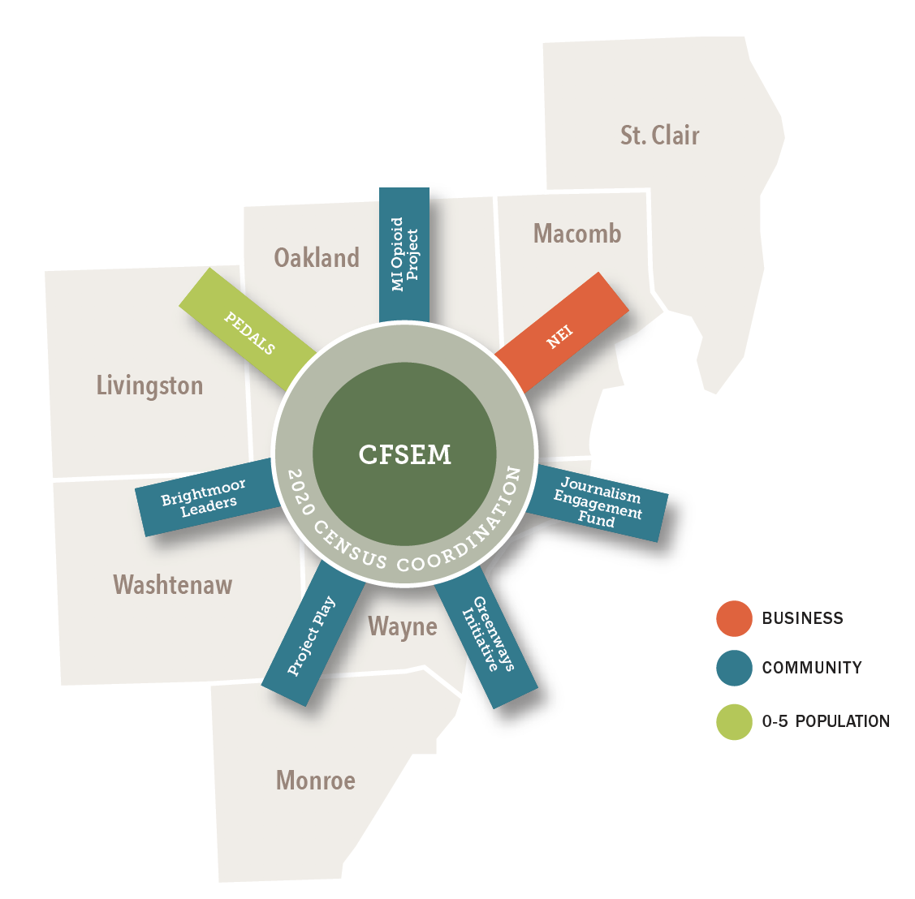
The Community Foundation supports donors and their charitable intentions, and funds, develops and nurtures programs that create lasting positive benefits for the region.
The Community Foundation creates permanent, positive change in southeast Michigan through thoughtful philanthropy.
2020 Census Grantee Convening
Notes:
Nonprofits are often among the most trusted messengers about the census for the communities they work in. CFSEM is fortunate to have existing relationships with many such organizations.

Slide 3

Staff Contacts
Melissa Smiley - msmiley@cfsem.org
Lenzi Abma - labma@cfsem.org
Mobo Ayeni - mobo@earlyworksllc.com
Mary Aviles –
mary@earlyworksllc.com
2020 Census Grantee Convening
Notes:
Please contact any of us for help.

Slide 4

Introductions
2020 Census Grantee Convening
Notes:
Go around the room and introduce yourselves. Please tell us your name, your organization, and tell us one thing you consider to be your super power.

Slide 5

Test Your Census Knowledge

Slide 6
QUESTION 1:
When will the 2020 census form be available for completion on the bureau’s website?
A. September – October 2019
B. March – July 2020
C. August – October 2020
ANSWER:
B. March – July 2020
The census bureau will conduct follow-up to households that have not completed the census May to July 2020
2020 Census Grantee Convening
Notes:
The census bureau will conduct follow-up to households that have not completed the census May to July 2020

Slide 7
QUESTION 2:
What will most households get in the mail about census 2020?
Invitation to respond & reminder letter
Postcard reminder for non-responding households
A picture of a cat
ANSWER:
A. Invitation to respond & reminder letter
Households will receive their first mailing encouraging self-response in March 2020. If they have not responded they will get a reminder postcard, reminder letter & paper questionnaire, followed by a final reminder postcard.
2020 Census Grantee Convening
Notes:
Households will receive their first mailing encouraging self-response in March 2020. If they have not responded they will get a reminder postcard, reminder letter & paper questionnaire, followed by a final reminder postcard

Slide 8
QUESTION 3:
How can households reply to the census?
Internet only
Paper only
Internet, phone, or paper questionnaire
ANSWER:
C. Internet, phone, or paper questionnaire
Non-census employees are not allowed to fill out another person’s form on line or on paper.
2020 Census Grantee Convening
Notes:
Non-census employees are not allowed to fill out another person’s form on line or on paper.

Slide 9
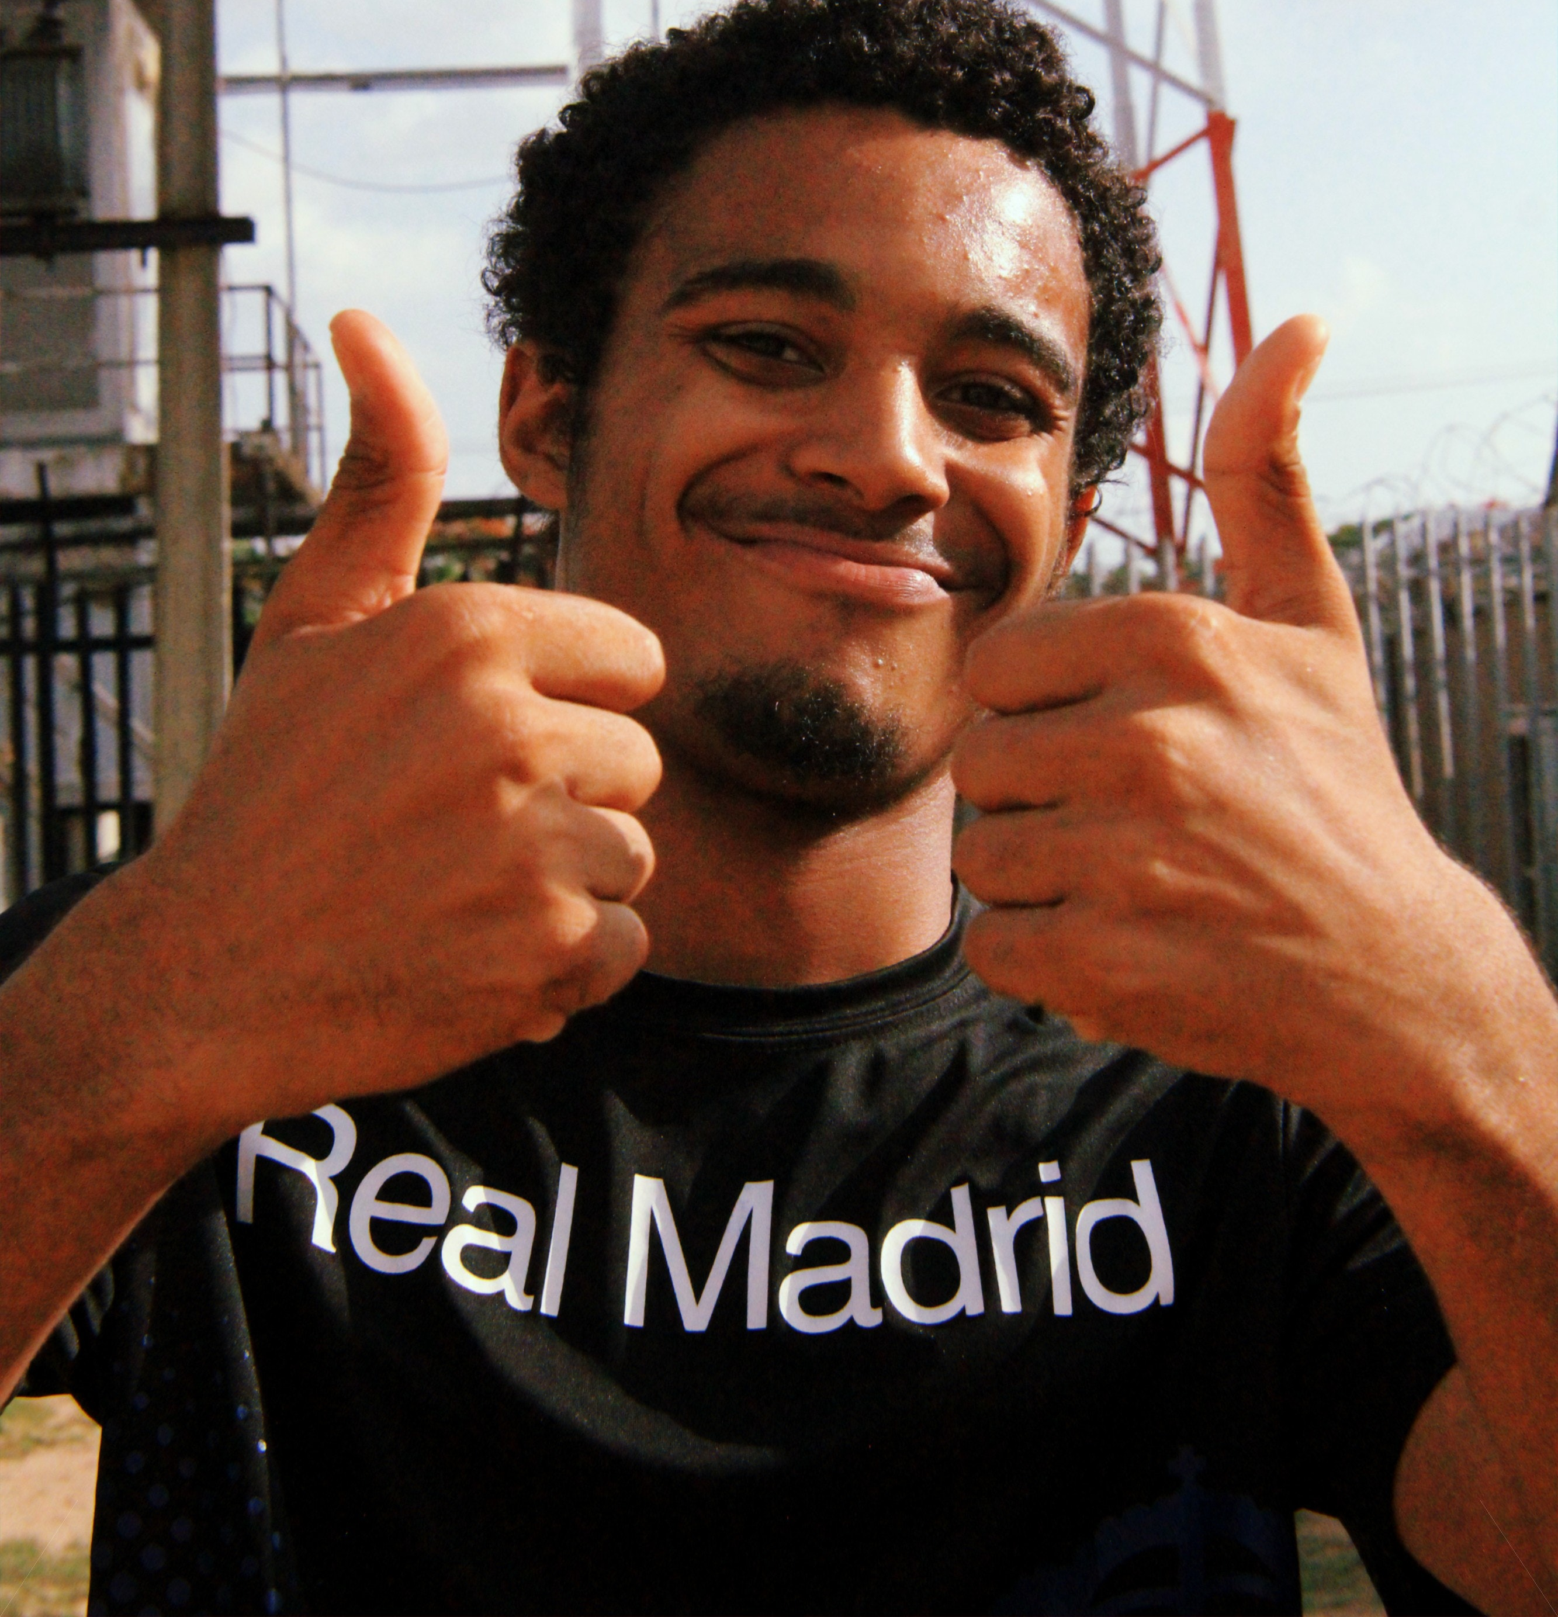
QUESTION 4:
What questions will be asked on the 2020 census?
Name
Relationship to owner or renter of home
Sex
Age
Date of Birth
Hispanic Origin
Race
All of the above
2020 Census Grantee Convening
Notes:
The Citizenship Question will NOT be on the census.

Slide 10
QUESTION 5:
True or False?
Anyone can go door to door with tablets or census forms to get people to complete their census.
ANSWER:
FALSE
Door-to-door canvassing to educate about the census and tell people about where they can go to access the form online is an acceptable alternative. You can also set up a table with tablets or computers at community centers or events where people can use the technology to fill out their census.
2020 Census Grantee Convening
Notes:
Door-to-door canvassing to educate about the census and tell people about where they can go to access the form online is an acceptable alternative. You can also set up a table with tablets or computers at community centers or events where people can use the technology to fill out their census.

Slide 11
QUESTION 6:
Where are people counted?
At work
At their “usual place of residence” (where they live & sleep most of the time)
At their vacation home
ANSWER:
B. At their “usual place of residence” (where they live & sleep most of the time)
This includes group quarters, which includes nursing homes, residential treatment centers, college/university housing, hospitals, and correctional facilities. The Census Bureau has a separate strategy for counting people living in group quarters.
2020 Census Grantee Convening
Notes:
Non-census employees are not allowed to fill out another person’s form on line or on paper.

Slide 12

QUESTION 7:
Can Southeast Michigan Counts Census grant funds be used to pay or otherwise incentivize people to complete their forms?
Yes
No
Maybe so
2020 Census Grantee Convening
Notes:
Non-census employees are not allowed to fill out another person’s form on line or on paper.

Slide 13

QUESTION 8:
What is the census data used for?
To determine the number of Congressional representatives for each state
To draw district boundaries
To plan for community needs including new roads, schools and emergency services
To decide where businesses should locate
To distribute billions of dollars to states and communities
All of the above
2020 Census Grantee Convening
Notes:
Non-census employees are not allowed to fill out another person’s form on line or on paper.

Slide 14

Resources
2020 Census Grantee Convening

Slide 15

The Community Foundation is working with organizations that are mobilizing communities for the 2020 Census.
A complete and
accurate count is
vital for communities; historically, some populations are undercounted.
2020 Census Grantee Convening

Slide 16
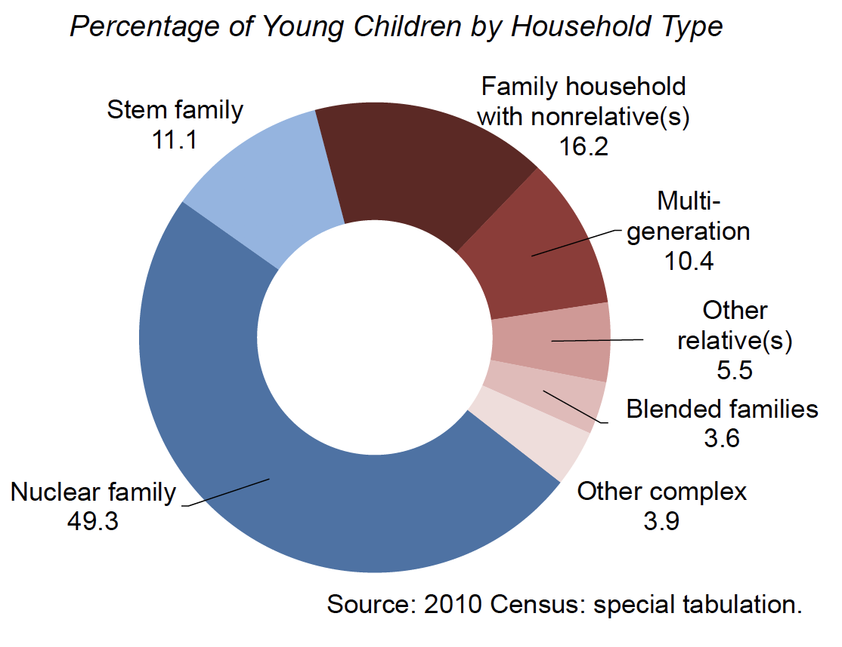
Traditionally undercounted groups include populations like communities of color, low-income households, immigrants, those distrustful of the government, people who move frequently, and young children.
2020 Census Grantee Convening
Notes:
0 – 5 stats: In the 2010 Census, the net undercount rate for young children was 4.6%, more than 2.2M in this age group were not included in the census results. This is a higher net undercount rate than for any other age group. The 0– 5 undercount has persisted since the 1990 census. The US Census Bureau estimates that 40 percent of children live in “complex” households and attribute some of the undercount to this phenomenon.
Business stats: 80 percent of US respondents trust their employers, even the disenfranchised (Edelman Trust Barometer, 2019)

Slide 17

English and these 12 languages account for languages spoken in over 99% of all households in the country.
These 12 languages match the non-English languages supported for the 2020 Census internet and phone response options.
2020 Census Grantee Convening
Notes:
Mention the items on the tables

Slide 18


Statewide Campaign
2020 Census Grantee Convening
Notes:
Including what they have to report on/how often

Slide 19




MICHIGAN NONPROFITS COUNT CAMPAIGN OVERVIEW

Slide 20
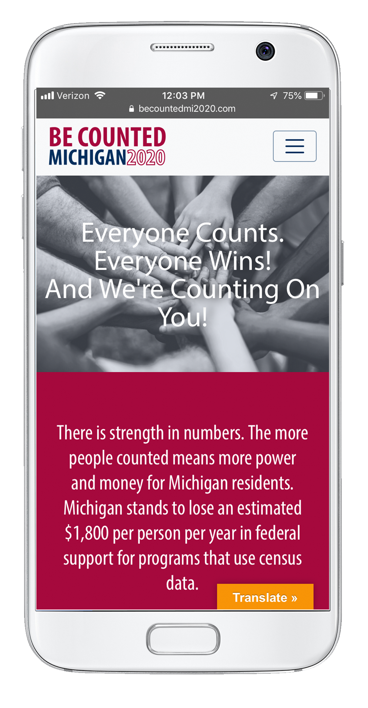
CAMPAIGN OVERVIEW
OUR CAMPAIGN
In July, 2017 Michigan Nonprofit Association (MNA) was awarded a 3-yr. grant from the W.K. Kellogg Foundation to launch 2020 Michigan Nonprofit Counts Campaign. Since then more than 40 foundations and the State of Michigan have invested in the campaign.
Modeled on a similar campaign MNA did for Census 2010, the 2020 Michigan Nonprofits Count Campaign is a collaborative, coordinated, statewide effort to encourage participation in the census in communities that are at significant risk of being undercounted.

Slide 21
STATEWIDE CAMPAIGN
You are part of a state-wide effort to ensure all Michiganders are counted.
There’s a tremendous amount at stake – and your work is vital.

Slide 22
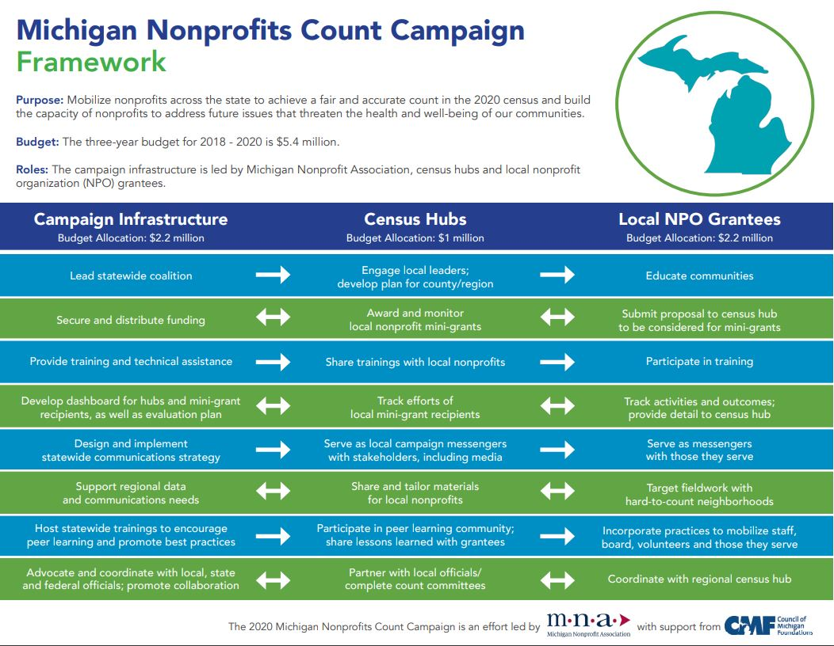

Slide 23
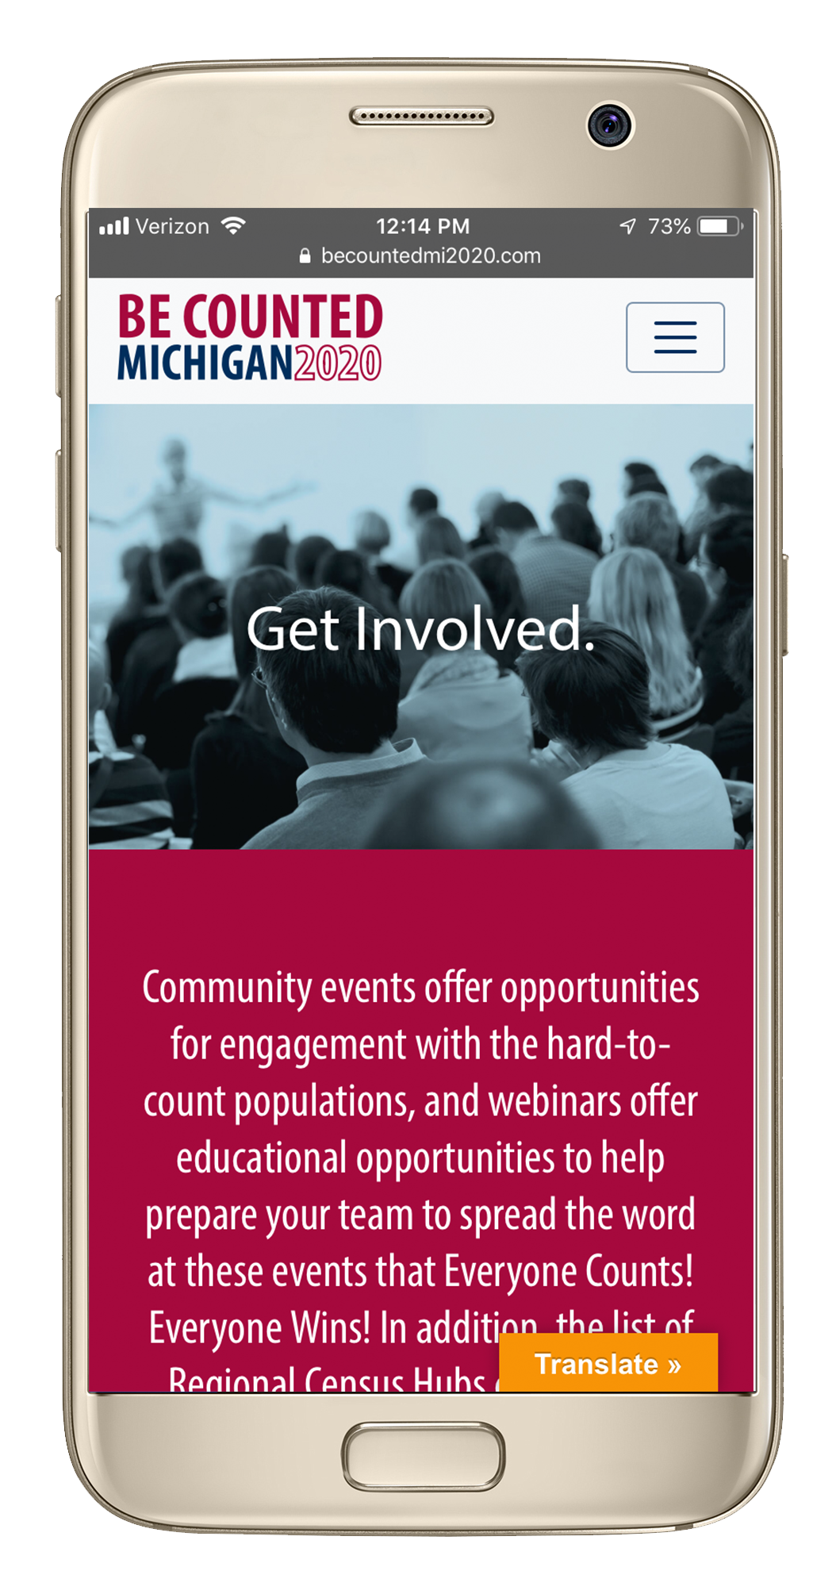
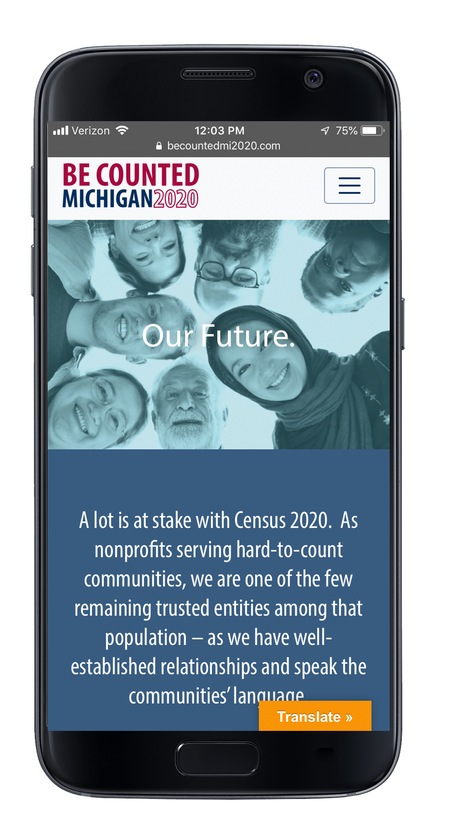
RESOURCES
www.becountedmi2020.com
Provide a resource repository of materials for nonprofits
Quarterly webinars for census advocates (records can be found on website)
Additional trainings being developed for grantees

Slide 24

Contact information
ntsai@mnaonline.org
(408) 334-6960 mobile
(313) 394-1995 office

Slide 25


City of Detroit
2020 Census Grantee Convening
Notes:
Including resources and how to make presentation requests, report misinformation

Slide 26
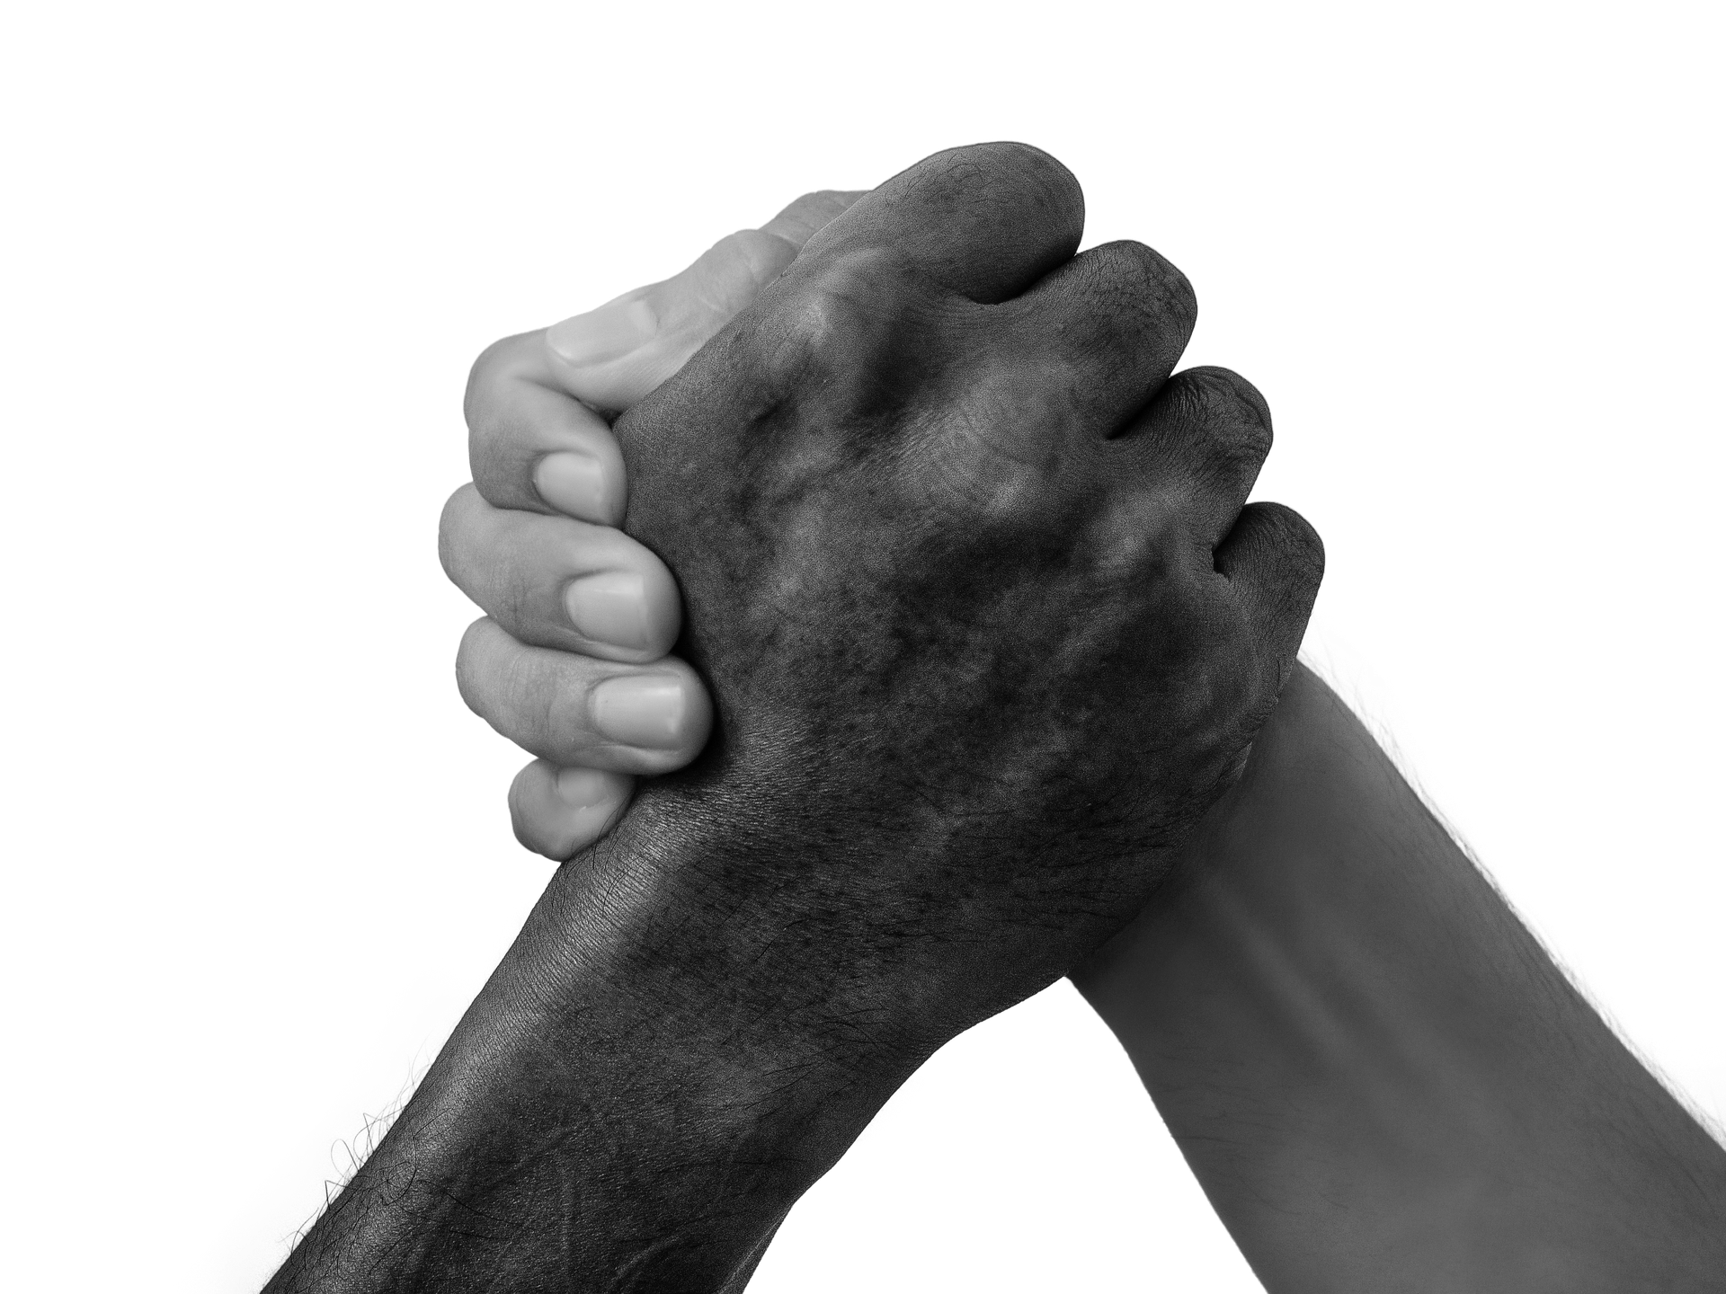
Breakout Groups
2020 Census Grantee Convening

Slide 27
INSTRUCTIONS:
Shift seats
Match table tent terms (5 min)
Share your project (20 min)
Discuss potential collaborations (10 min)
Elect + share (1 project + 1 idea) (10 min)
Give feedback (5 min)

Slide 28
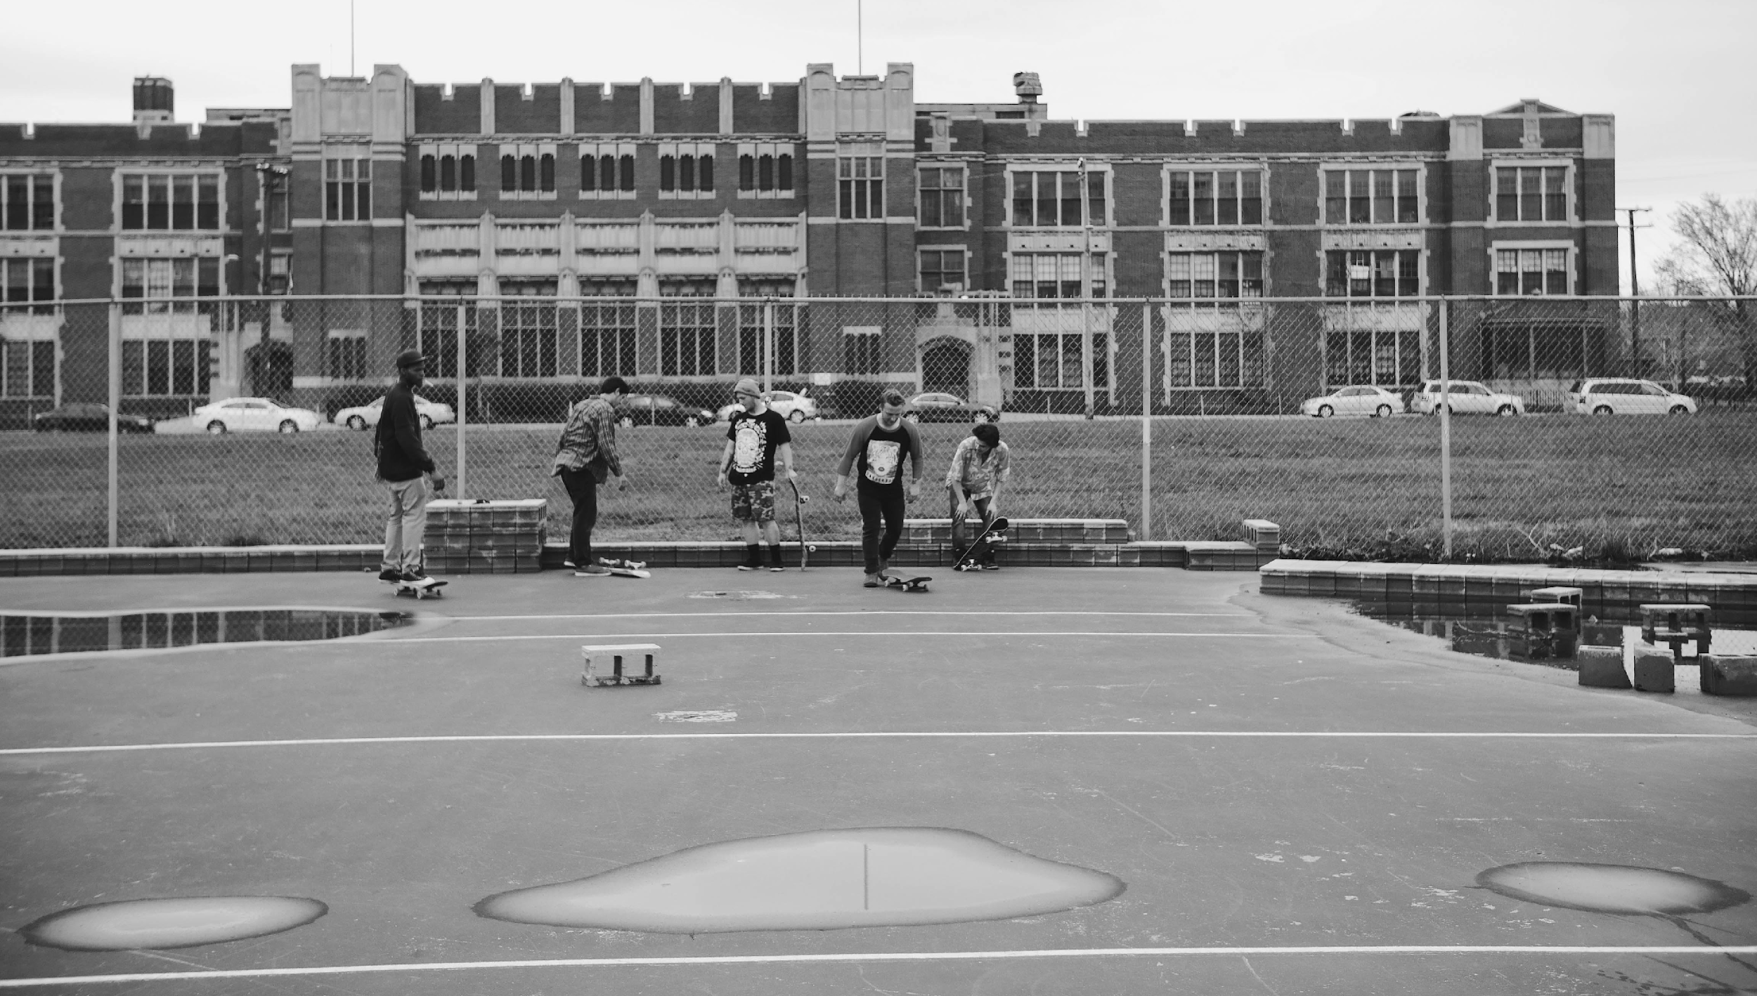
Message Maps + Media
2020 Census Grantee Convening

Slide 29
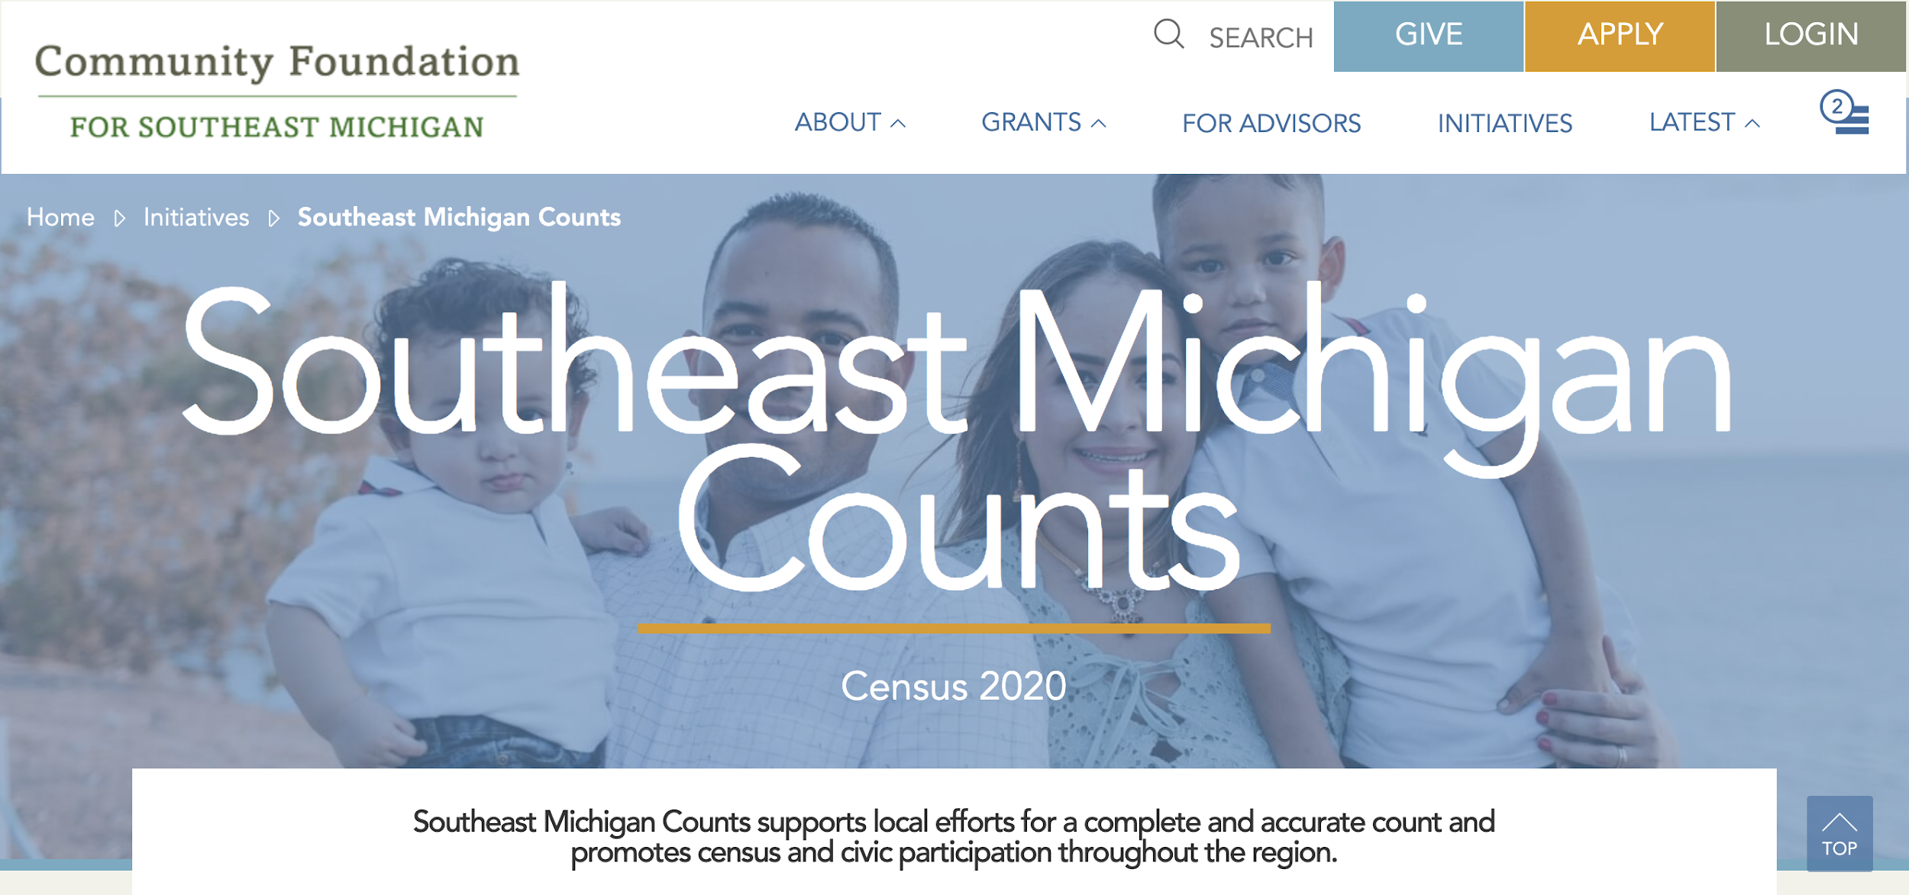

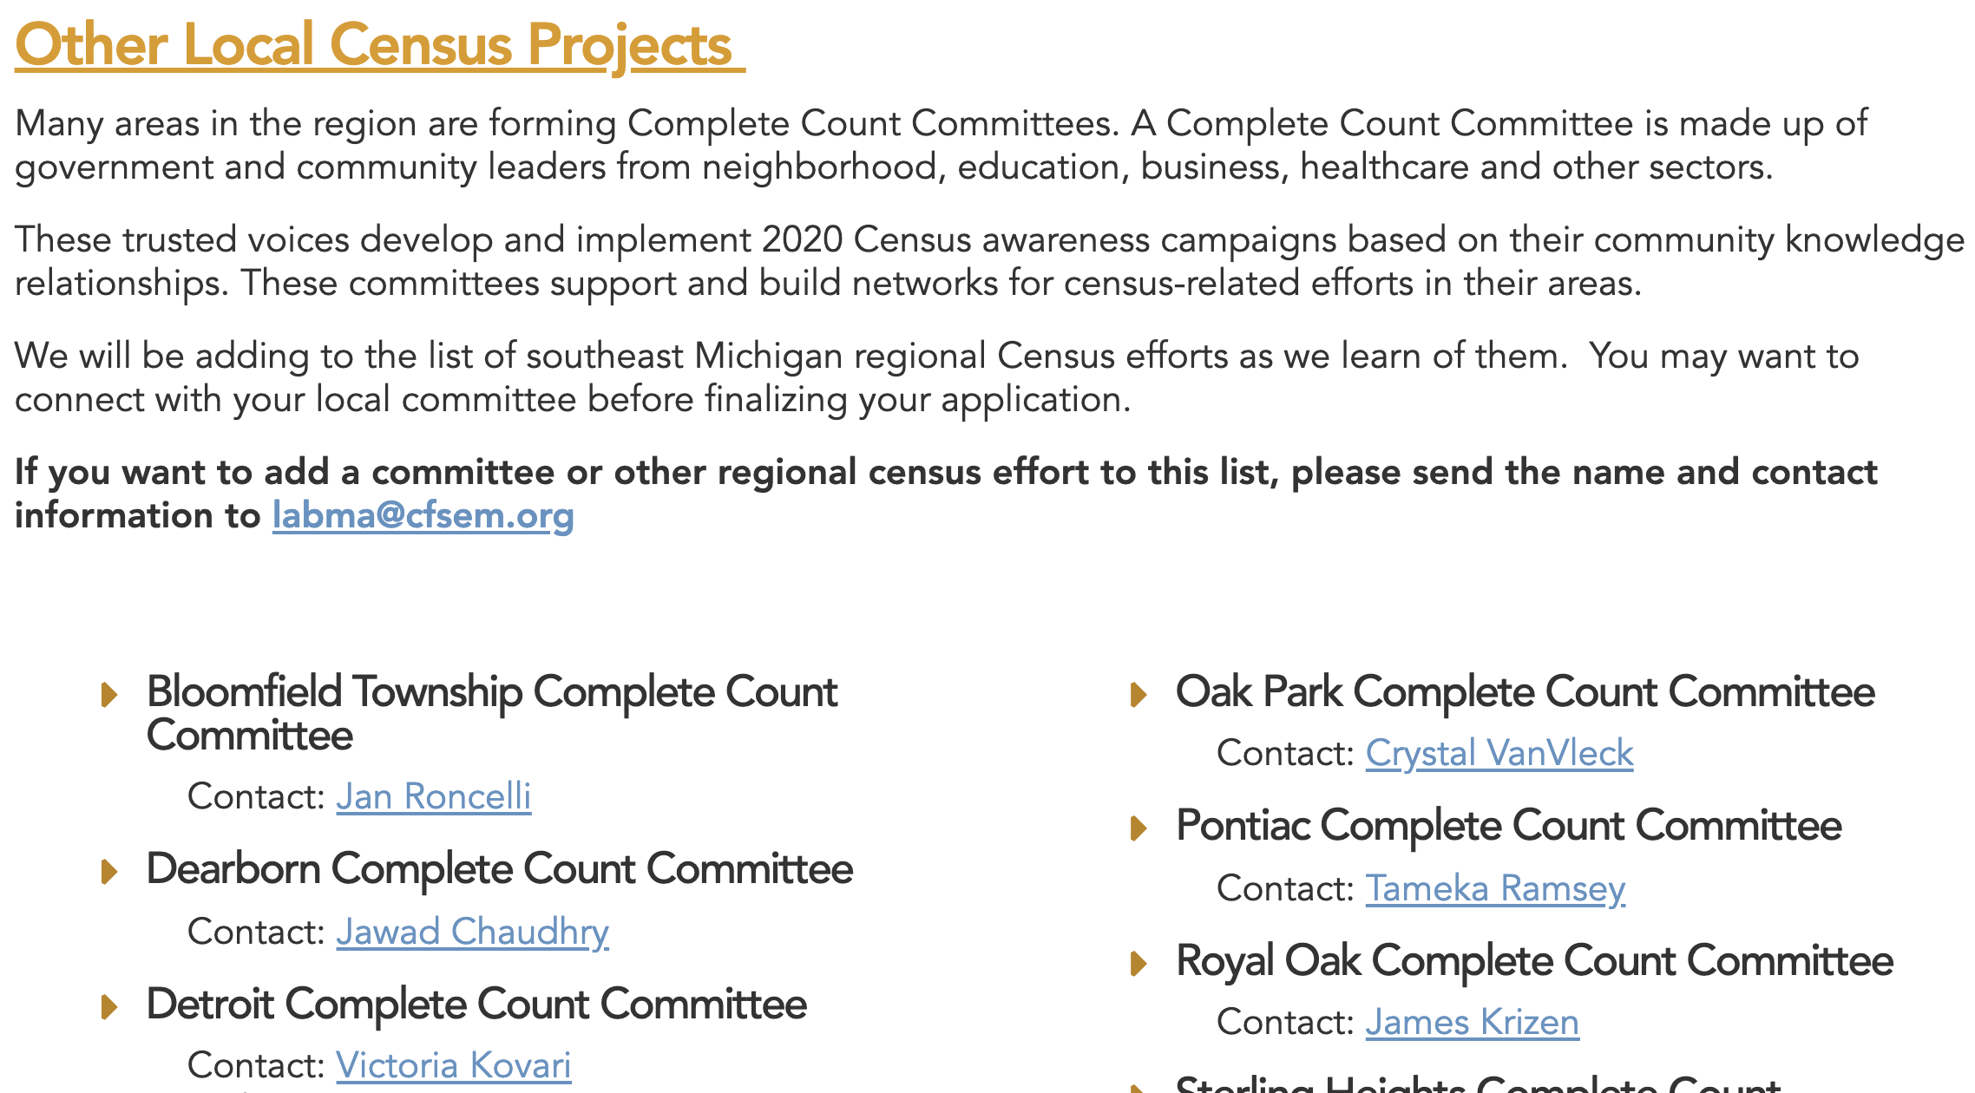
We are collecting information and area Complete Count Committee activity on our site, and anyone can use what we have listed there.
When people understand what the census is, how information is used,
and how they can
get counted, it
translates into higher participation rates.
2020 Census Grantee Convening

Slide 30
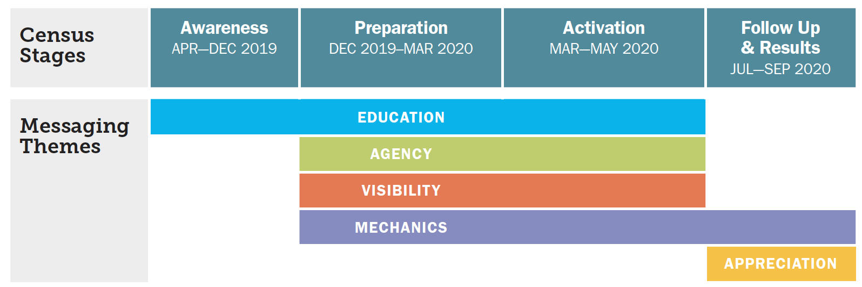
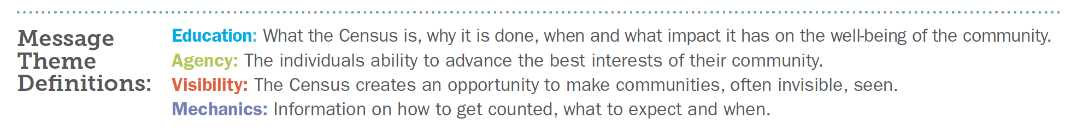
Sequencing targeted messages can help keep your communities engaged.
There are four main components to census communication planning:
2020 Census Grantee Convening

Slide 31
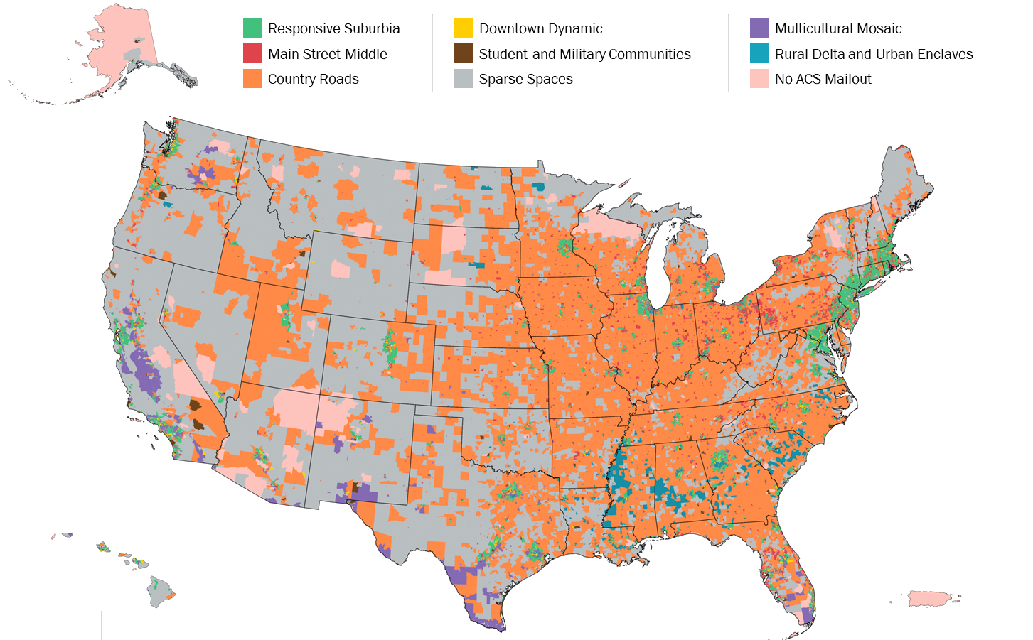
The Census Bureau developed six mindsets and eight tract segmentations that may be helpful when crafting your communications.
Messages about personal agency and the role of census in providing funding for community services, like roads, safety services, hospitals, and schools are most effective.
2020 Census Grantee Convening

Slide 32
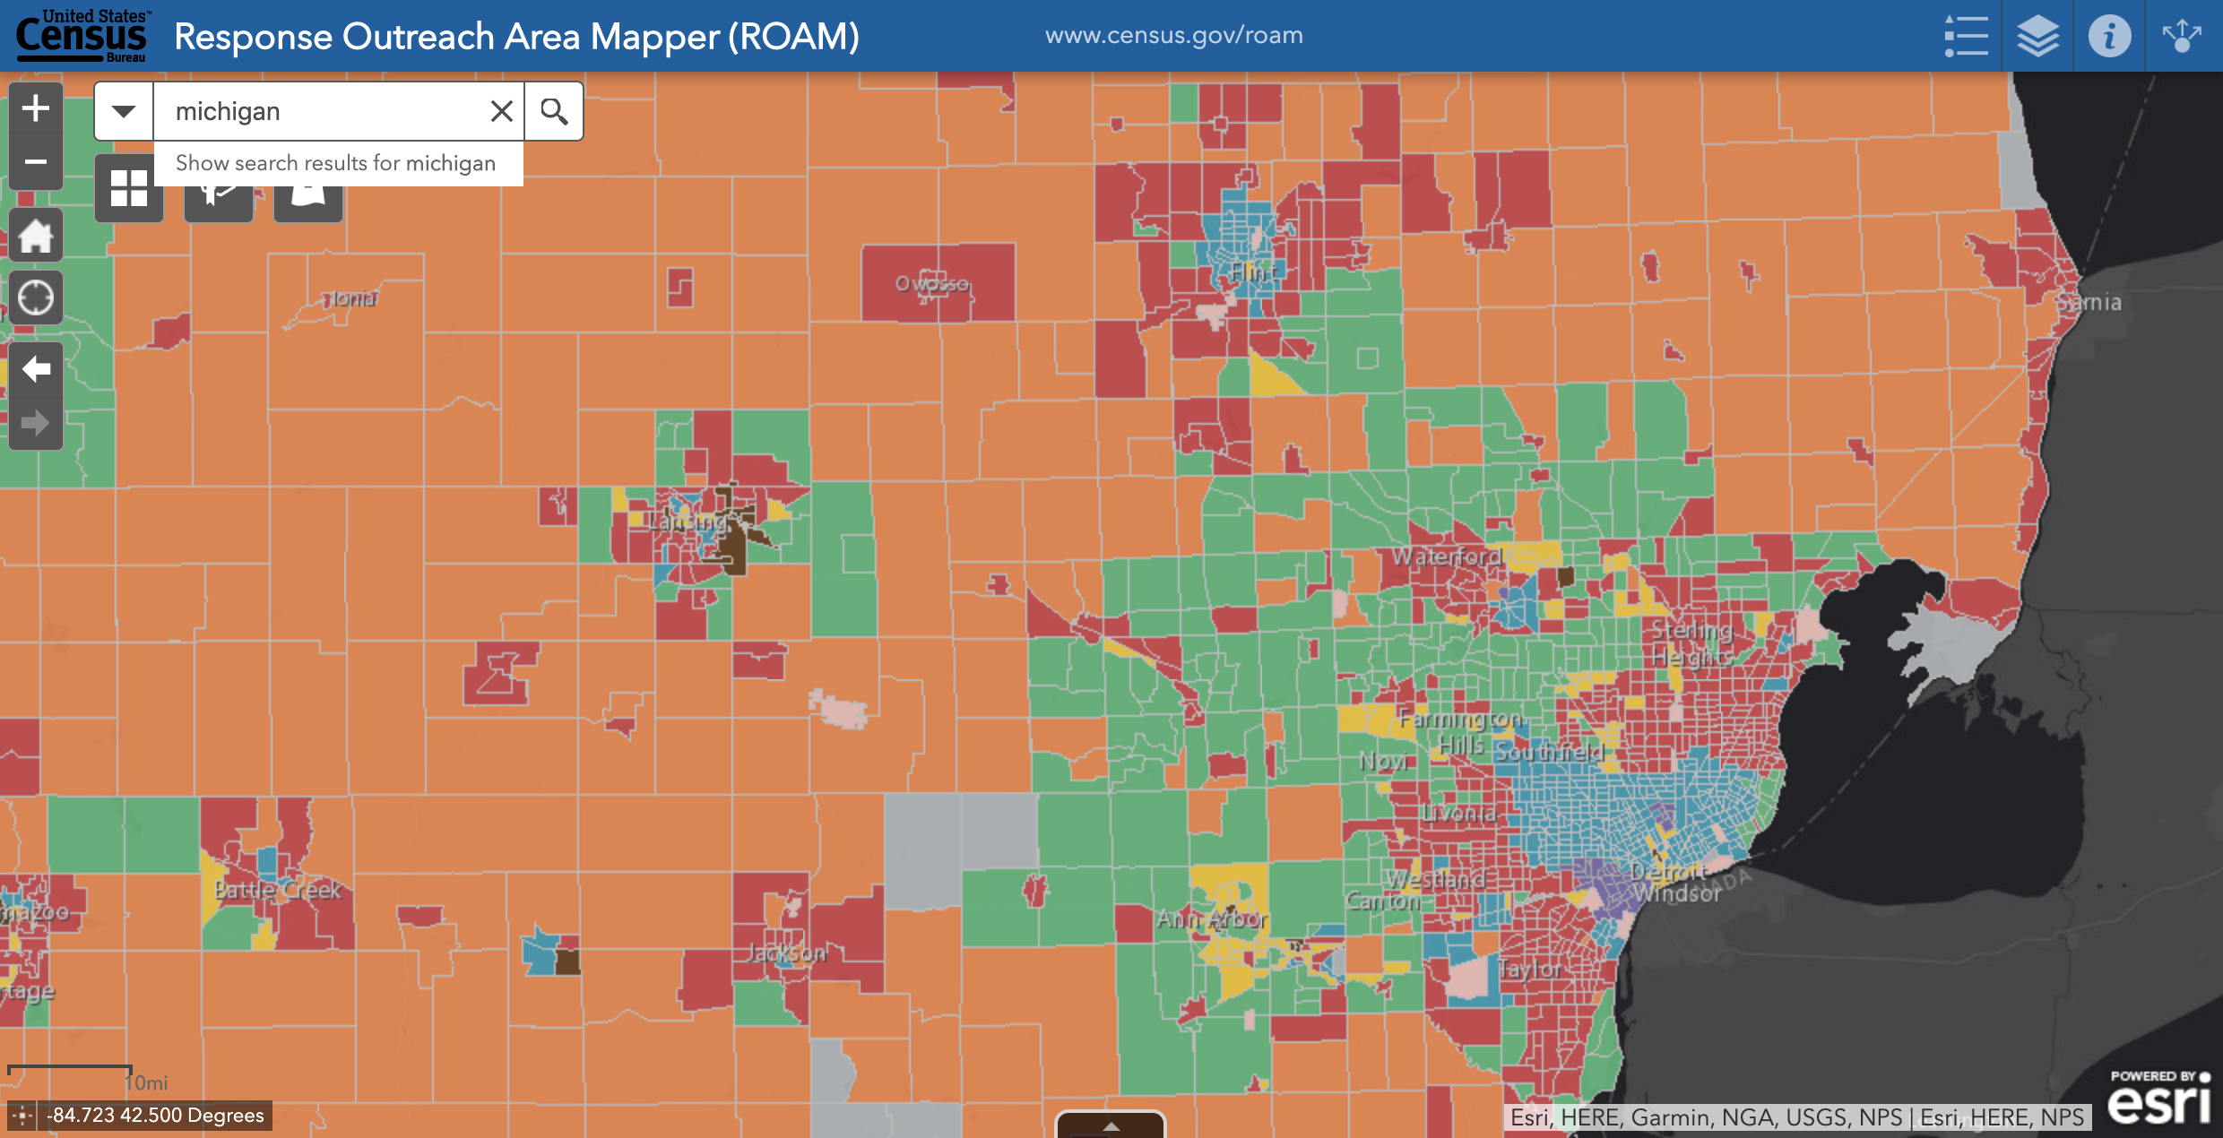
Notes:
Urban Enclaves
Main Street Middle
Downtown Dynamic
Multicultural Mosaic
Responsive Surburbia

Slide 33
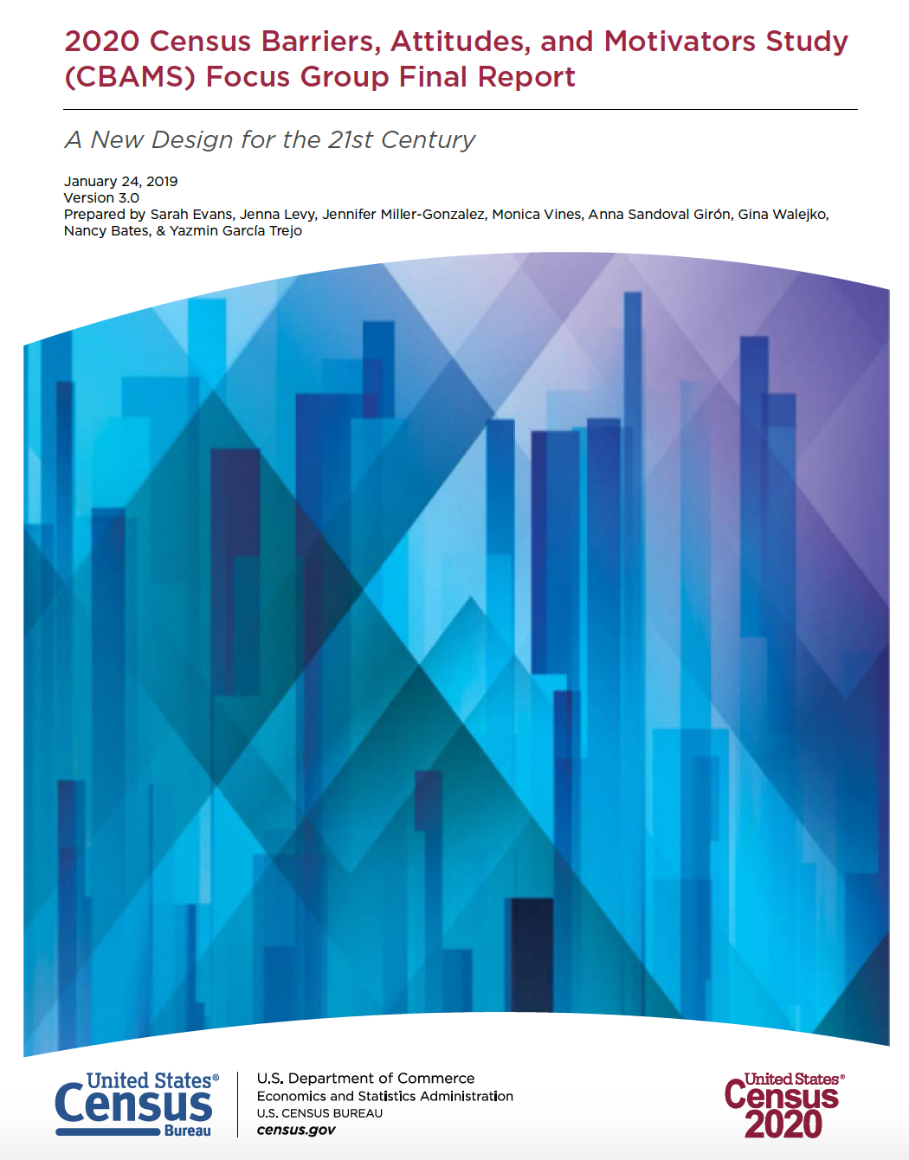
Tailor messages reflective of your specific audiences.
Fear of repercussion is a common reason for NON-RESPONSE across several historically-undercounted populations. However, the specifics are nuanced.
“Like if you get food stamps, you’re allowed to have three different households in one household and just declare it like that, but some people don’t understand that and they will be afraid that it’s going to affect their food stamp if they report somebody else is there.”
“Every single scrap of information that the government gets goes to every single intelligence agency, that's how it works…”
“…if you find [undocumented people to fill out the census], they won’t tell you either, that they have no documents.”
“I’m afraid that the City of Detroit will find out that my car is registered in the suburbs at my parent’s house.”
2020 Census Grantee Convening
Notes:
Black or African American, Native Hawaiians and Pacific Islanders (NHPI), Middle Eastern or North African (MENA), Spanish (U.S. Mainland), and Chinese audiences ALL cited fear of repercussion as a top reason NOT to respond.

Slide 34

Wish List
2020 Census Grantee Convening
Notes:
Support for Differently Abled + Other Needs

Slide 35
Contact Database

Slide 36
Media Connections

Slide 37
CFSEM.org/Census
8.9.2019

